Slide 1
WEB APPLICATION FIREWALL
SECURITY
Presented By:
1. Student Name:G.Nithish kumar
College Name:The Kavery Engineering College
Department:B.E-Computer Science and Engineering

Slide 2
OUT LINES
Problem Statement (Should not include solution)
Proposed System/Solution
System Development Approach (Technology Used)
Algorithm & Deployment
Result (Output Image)
Conclusion
Future Scope
References

Slide 3
INTRODUCTION
A web application firewall (WAF) is a security solution that protects web applications from a variety of attacks, such as cross-site scripting (XSS), SQL injection, and other common threats. It monitors and filters HTTP traffic between a web application and the internet, helping to prevent unauthorized access and data breaches. WAFs can be deployed as hardware appliances, software solutions, or cloud-based services, and they often use a combination of signature-based and behavior-based detection techniques to identify and block malicious traffic

Slide 4
PROBLEM STATEMENT
"Despite implementing a web application firewall, our system still faces vulnerabilities and security breaches, indicating potential gaps in the WAF's protection. We need to identify and address these issues to ensure comprehensive security for our web applications.".
Incomplete Rule Set: The current rule set deployed in the WAF may not adequately cover all potential attack vectors and vulnerabilities present in our web applications. This could leave certain entry points unprotected and vulnerable to exploitation.

Slide 5
PROPOSED SYSTEM & SOLUTION
Certainly, let's outline a proposed system and solution for enhancing web application firewall (WAF) capabilities:
Enhanced WAF Platform: Implement a modern, robust WAF platform capable of providing comprehensive protection against a wide range of web application attacks.
Real-time Monitoring and Analysis: Integrate advanced real-time monitoring and analysis capabilities into the WAF platform to detect and respond to threats promptly.
Threat Intelligence Integration: Incorporate threat intelligence feeds and updates into the WAF platform to stay abreast of emerging threats and enhance detection accuracy..

Slide 6
Monitoring and Logging: Implement monitoring and logging mechanisms to track WAF performance and security events. Real-time alerts can notify administrators of potential threats or breaches.
Testing and Optimization: Conduct thorough testing of the WAF implementation to ensure it effectively mitigates threats without impacting legitimate traffic. Continuously optimize the configuration based on insights gathered from monitoring and testing
Maintenance and Updates: Regularly update the WAF to address newly discovered vulnerabilities and emerging threats. Perform periodic security assessments to identify and remediate any weaknesses in the system.

Slide 7
System Development Approach
Developing a web application firewall (WAF) involves a systematic approach to ensure effectiveness and reliability. Here's a step-by-step development approach:
Define Requirements: Gather requirements by understanding the nature of the web application, its vulnerabilities, compliance needs, and expected traffic volume. Define specific security policies and functionalities required for the WAF.
Choose Development Framework: Select a development framework that aligns with your project requirements and expertise. Popular choices include programming languages like Python, Java, or frameworks like Nginx for reverse proxy-based WAFs.
Design Architecture: Design the architecture of the WAF system, considering factors such as scalability, performance, and ease of maintenance. Decide whether the WAF will be implemented as a module within the web server, as a reverse proxy, or as a standalone application.

Slide 8
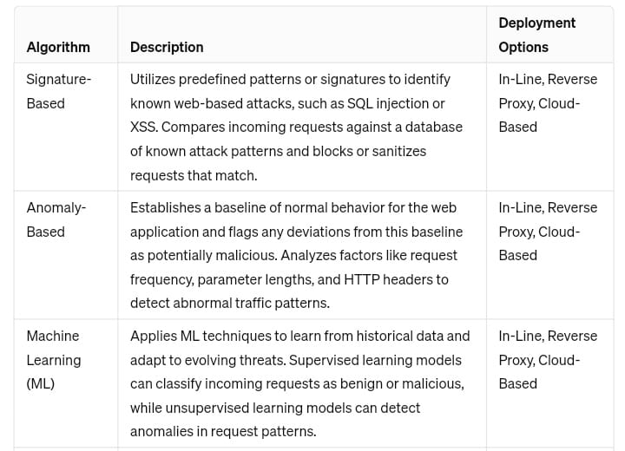
Algorithm & Deployment

Slide 9
class WAFRequestHandler(BaseHTTPRequestHandler):
blocked_ips = set(["1.2.3.4", "5.6.7.8"]) # Example of blocked IPs
def do_GET(self):
client_ip = self.client_address[0]
if client_ip in self.blocked_ips:
self.send_response(403)
self.end_headers()
self.wfile.write(b"Forbidden")
else:
self.send_response(200)
self.end_headers()
self.wfile.write(b"Hello, World!")
def run_server(server_class=HTTPServer, handler_class=WAFRequestHandler, port=8000):
server_address = ('', port)
httpd = server_class(server_address, handler_class)
print(f"Starting server on port {port}...")
httpd.serve_forever()
if _name_ == '_main_':
run_server()

Slide 10
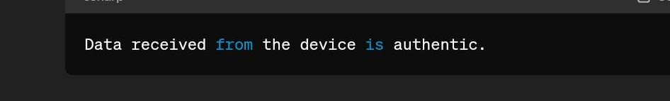
RESULT(OUTPUT)

Slide 11
CONCLUSION
Concluding a discussion on web application firewalls (WAFs) involves emphasizing their critical role in protecting web applications from various attacks, such as SQL injection, cross-site scripting, and DDoS attacks. It's important to highlight the benefits of WAFs in providing an additional layer of security, mitigating risks, and ensuring compliance with regulatory requirements. Additionally, discussing the importance of regular updates, monitoring, and fine-tuning to adapt to evolving threats is crucial for maintaining effective protection. Overall, integrating a WAF into your security strategy can significantly enhance the security posture of your web applications..

Slide 12
FUTURE SCOPE
API security
Behavioral analysis
Edge computing
container Security
Zero trust architecture
Serverless security
Compliance and reporting

Slide 13
REFERENCE
"Web Application Firewalls: A Practical Approach" by Ryan C. Barnett, Jeremiah Grossman, Robert Auger
This book provides a comprehensive overview of web application firewalls, including implementation strategies, best practices, and real-world case studies.
"The Web Application Hacker's Handbook: Finding and Exploiting Security Flaws" by Dafydd Stuttard, Marcus Pinto
While not solely focused on WAFs, this book offers valuable insights into web application security, including discussions on how WAFs work and common evasion techniques.
"OWASP Top Ten Project" by The Open Web Application Security Project (OWASP)
OWASP's Top Ten project highlights the most critical web application security risks, including vulnerabilities that WAFs aim to mitigate. The project provides detailed information on each risk, along with recommendations for prevention and detection.

Slide 14
...THANK YOU...

